Slide 1
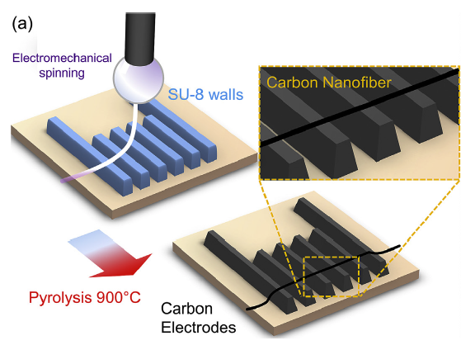
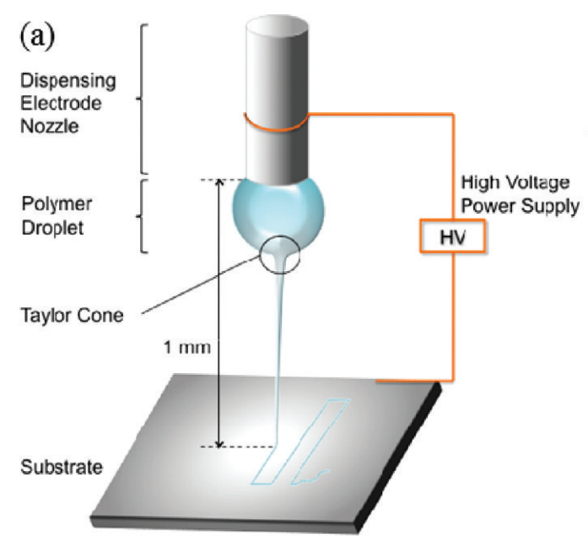
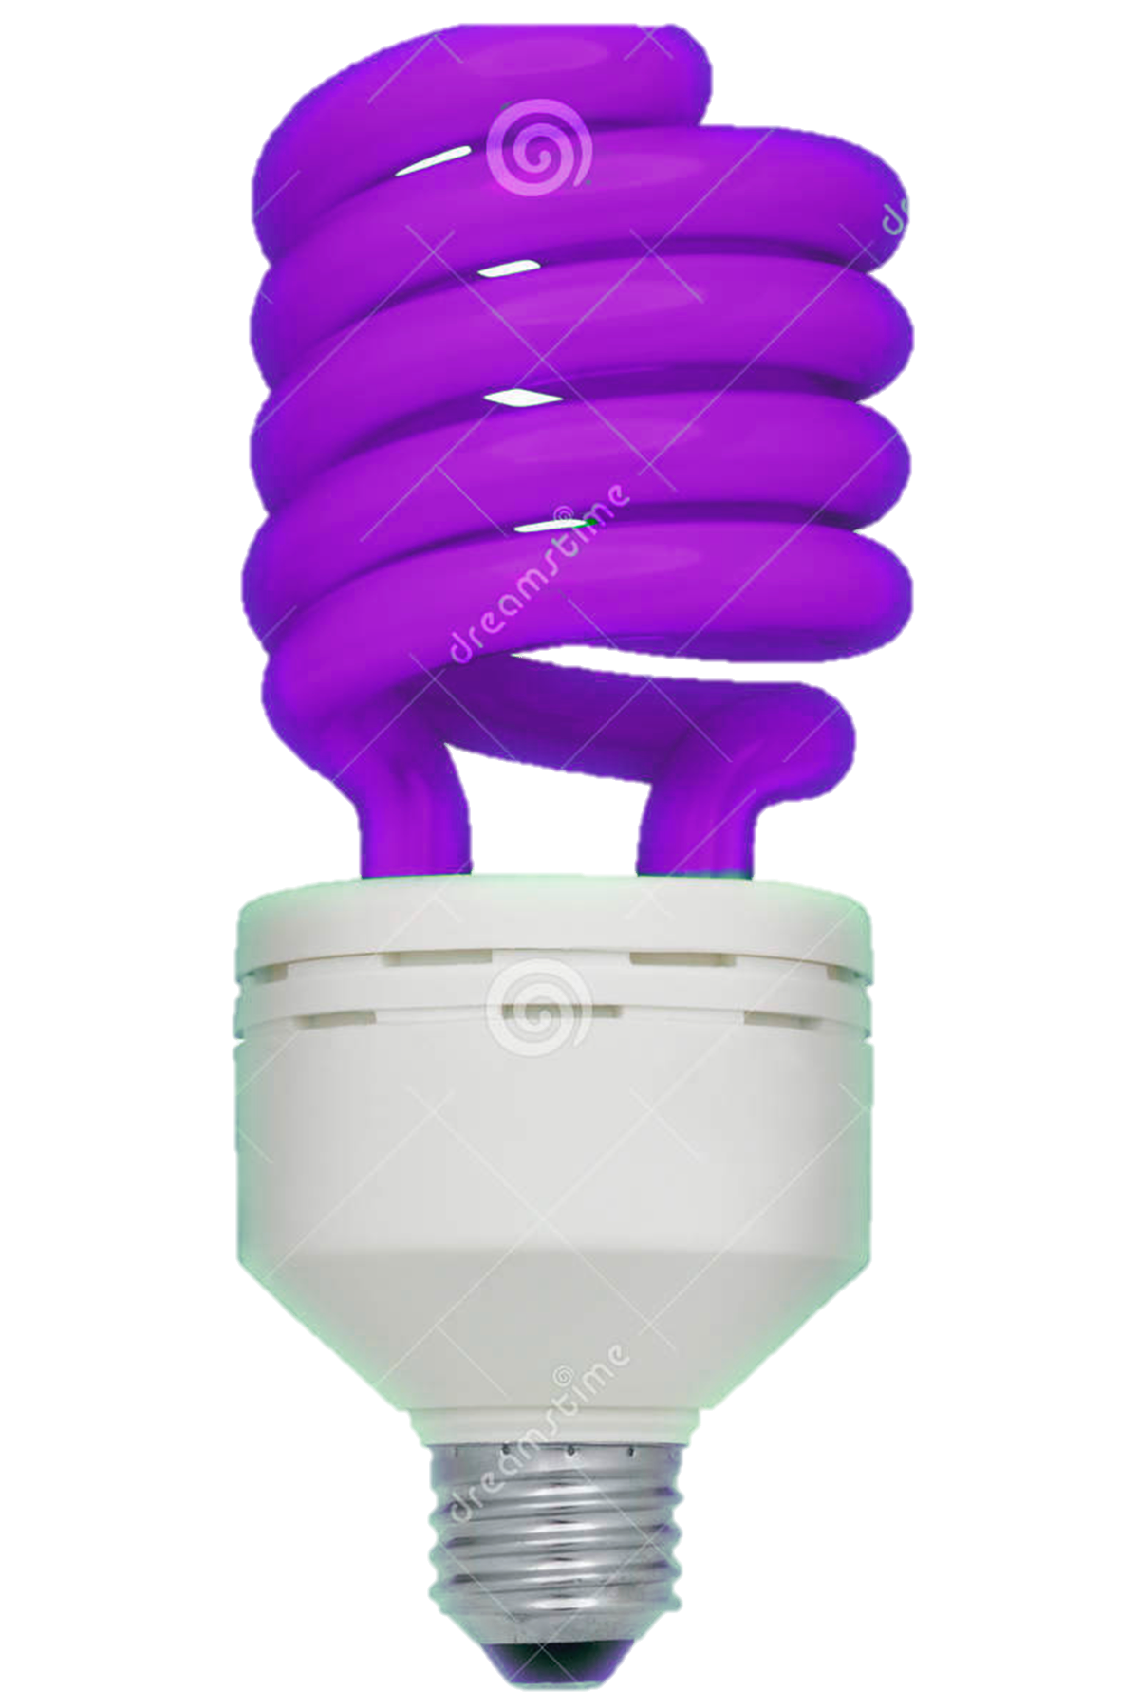
Design of polymer solutions for the fabrication of carbon nano-wires
Goal: Design polymer solutions that can be electrospun by NFES or mechano-spinning, photopolymerized and pyrolyzed into conducting carbon nanowires for biosensors.
Polymer solution
Problem: Carbon nanowires have been fabricated with a photoresist, but little is know about polymers that can produce more conductive carbon nanowires after pyrolysis.
Strategy: Analyze the rheology of different polymer solutions to determine if they can be easily electrospun at low voltages and then fabricate nanowires with them.
Salazar et al., Carbon, 2017, 115, 811-818.
Sharm et al., Langmuir, 2010, 2218-2222
Bisht et al., Nano Letters, 2011, 11, 1831-1837
Contacts:
Alan Aguirre Soto alan.Aguirre@tec.mx
Dora Medina

